Slide 1
I Catalyze Profitable Growth in Organisations through Deeper Customer Understanding, by:
Building Bigger Brands.
Increasing your impact.
Supporting your customer-first strategy.
Growing the ROI of your information investments.
Denyse Drummond-Dunn, The “1-Day Catalyst”
A customer-first strategy is essential to the satisfaction and delight of today’s savvy consumers, customers, clients. For a business to succeed, it involves evaluating and taking appropriate action in three areas:
COMPANY structure, vision & strategy
BRAND positioning, innovation & KPIs
PROCESS optimisation in engagement and knowledge sharing
All three areas require a deep understanding of the CUSTOMER, and insights on which to base your actions. My goal is to support and inspire your journey, to ensure success for both you and your business.
After more than thirty years in senior global executive roles, I know customers! I’ve personally spoken to them in over 100 countries around the world and probably know a lot about yours already!
“Customer centricity is a journey, not a destination!”
A Customer-First Strategy requires an executive sponsor and a strong and charismatic leader to excite and motivate everyone within the organisation to join the journey. However, translating that journey into a customised plan of action is complex. That’s where the business catalyst provides most value. Without a clear understanding of how the four areas fit together, how to maintain motivation while adapting the corporate culture, and how to solve the challenges that arise, you will certainly struggle and probably fail!
This is where I help.
Whatever the size of your organisation or the industry in which you are working, I significantly reduce the stumbling blocks along the way. And you get an experienced sounding board and inspiring supporter who is always available whenever the going gets tough.
The advisory process I propose is planned around three-month blocks, which can be renewed as needed. This approach has been extremely successful and is highly appreciated by my clients. It enables them to make fast and noticeable progress, while giving them the freedom to adapt and adjust their journey. Putting the customer at the heart of a business requires different strategies and tactics for each company; no off-the-shelf products, only personalised answers are what you get.

Slide 2
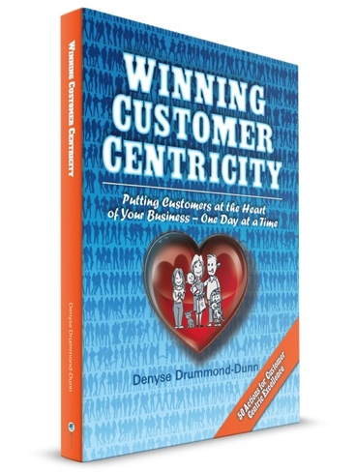
Customer First Strategy Service Deliverables:
Review of your current situation: your internal support, mission, objectives, team, information sources and current processes.
Assessment of your level of customer centricity in the four foundational areas.
Discussions with the leaders and department heads both locally and globally (where relevant) to gain their support and to engage them behind the initiative, by showing them its value and growth potential.
Development together of a roadmap, timeline and milestones for the execution of required changes.
1-2 day kick-off workshop.
All tools and templates required to build and optimise each key area.
License for the internal use of tools, templates and presentations to inform all employees of the progress at each milestone.
Optional additional services offered:
Participation and presenting at internal meetings, seminars, workshops.
Review of current information availability and processes used to gather data.
Negotiation of information services and contracts.
Typical Summary Process
Weeks 1-4
Assessment of current position in the four key areas.
Weeks 5-6
Gain executive support & form project team.
Understand organisation, culture; identify key stakeholders
Prioritise focus areas.
Weekly plan & progress review with project team.
Weeks 10-12
Weeks 7-9
Weekly calls with project team.
Identify actions & set plan.
Progress key areas.
Implementation of customer connections.
Review progress & communicate.
Monthly customer knowledge sharing with whole organisation.
Weekly team calls.
This first 3-month period is usually followed up by ongoing support through additional projects or a retainer.
My guarantee to you:
I’ve worked in the corporate world for more than thirty years. So I know only too well that things don’t always go according to plan; priorities change. When we work together, I will always be here for you. I’m flexible & adapt easily to your changing work constraints and priorities.
To advance your career and lead the customer-first strategy in your own organisation, contact Denyse:
denysedd@c3centricity.com or +41 79 933 9789

Slide 3
Other Services Offered:
Besides my senior management advisory service, I also work with middle and upper management in the following areas:
Internal training on many topics around customer centricity and brand building. Full details can be found at c3centricity.com/training where you will also be able to download the summary brochures. Topics covered include:
I3: Improved Ideation and Innovation
M3 More Meaningful Market research
N3: New, Next-generation iNsights.
I2A: Insights into Action.
I2I: Insights to Impact.
S3: Strategic viSion with Scenarios.
B3: Boosting Bolder Business.
C3: Consistent, Creative Communications
Keynote and Speaking on topics around customer centricity and brand building. Recent presentations given in the US, India, China, Peru, Switzerland, Belgium and Germany were on the following topics:
Customer Centricity is our Future: Turning Insights into Action.
Why Customer Centricity and not Technology is the Future of Market Research
Customer First Strategy & CatSight™ - The 7-Step Process for Developing Actionable Insights (workshop).
What a Customer First Strategy Means Today: How to Finally Walk the Talk.
A Customer First Strategy: Your Secret Weapon To Business Profitability! (For professionals who want more impact & growth.)
Growing a Profitable Business through a Customer First Strategy.
Executive Advisory Position / Sounding Board for the management of new or existing clients. It can be lonely at the top, no? Wouldn’t it be great to have someone who is always there for you? With whom you can brainstorm or validate your ideas with before exposing them internally? I provide the coaching and advice top managers need, especially when you are relatively new in an organisation, or in times of difficult challenges and management upheavals.
I am the wise advisor and support you secretly dreamed of having just for you!

